Slide 1
Results of the week
Daniil Terebilenko
Junior DevOps Engineer

Slide 2


AWS Pricing Calculator
Easy Amazon EC2 Instance Comparison

Slide 3
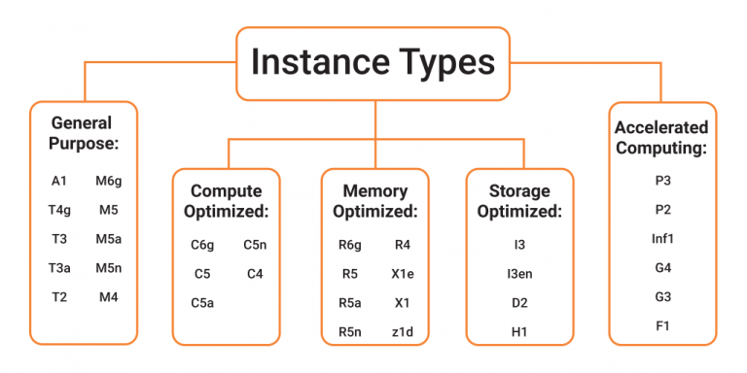
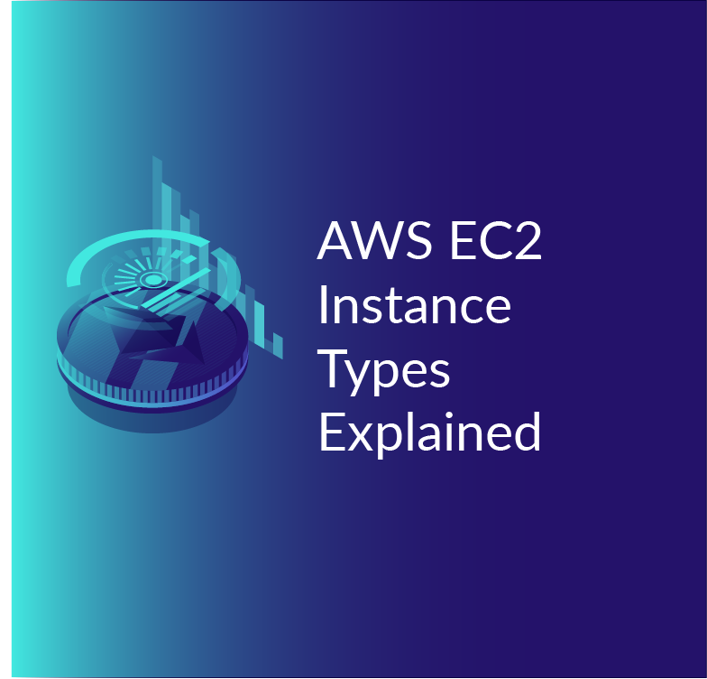
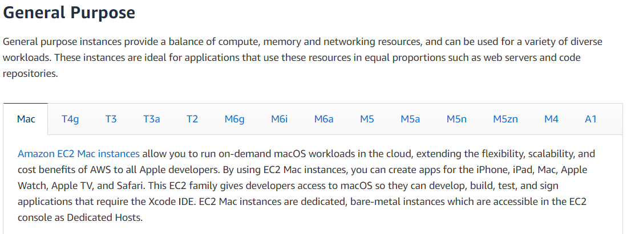

Slide 4





Slide 5


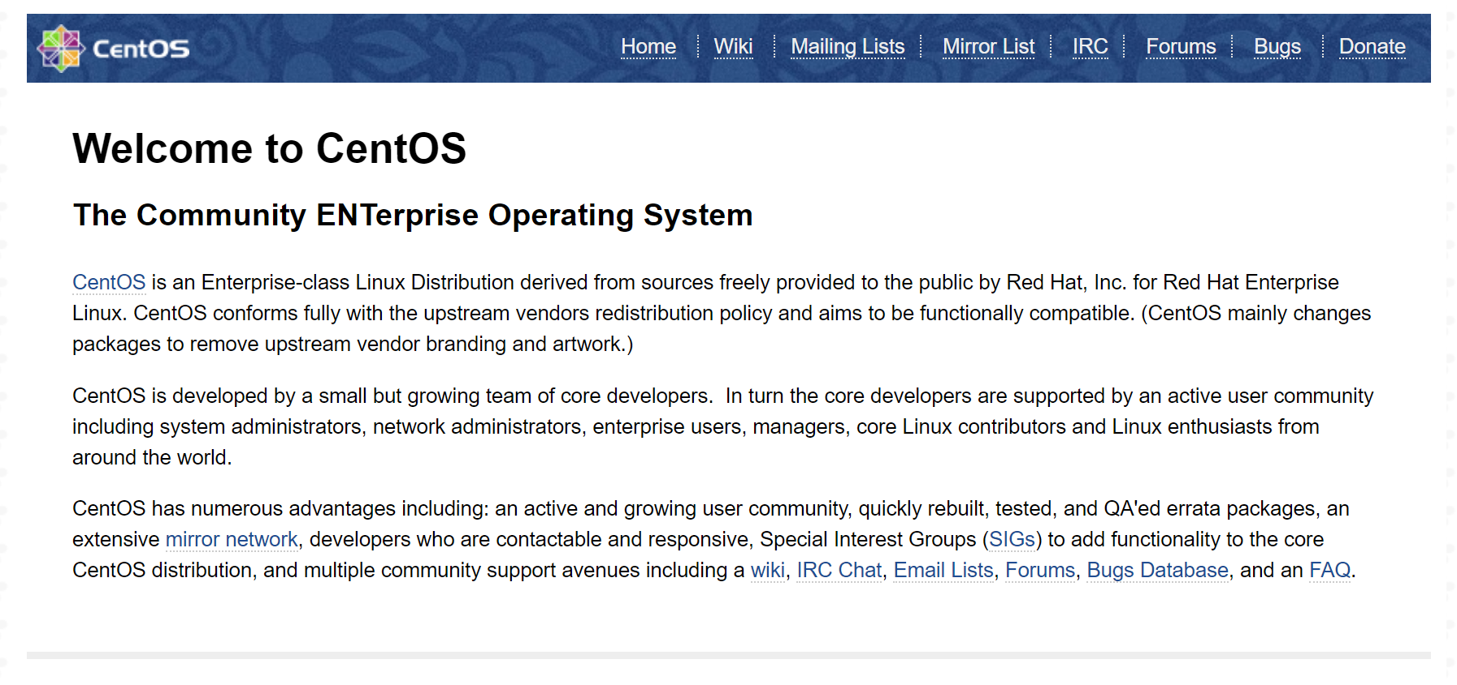

Slide 6

Python

